Slide 1

Keylogger And security
Student name : Ramjan Begam I
College name : anjalai ammal mahalingam engineering college
Department:computer science and engineering

Slide 2
Problem statement
In today’s digital age, where cybersecurity threats loom large, one of the significant concerns is the proliferation of keyloggers, stealthy software tools designed to monitor and record keystrokes on a user’s computer without their knowledge. Keyloggers pose a severe threat to individuals and organizations as they can capture sensitive information such as passwords, credit card details, and other personal data, leading to identity theft, financial loss, and privacy breaches.

Slide 3
Proposed Statement
In the current digital landscape, characterized by prevalent cybersecurity risks, the widespread presence of keyloggers emerges as a critical concern. These stealthy software tools clandestinely monitor and record keystrokes on users’ computers, potentially compromising sensitive data including passwords, credit card information, and personal details. Such infiltration poses grave threats to both individuals and organizations, as it can result in identity theft, financial harm, and breaches of privacy.”

Slide 4
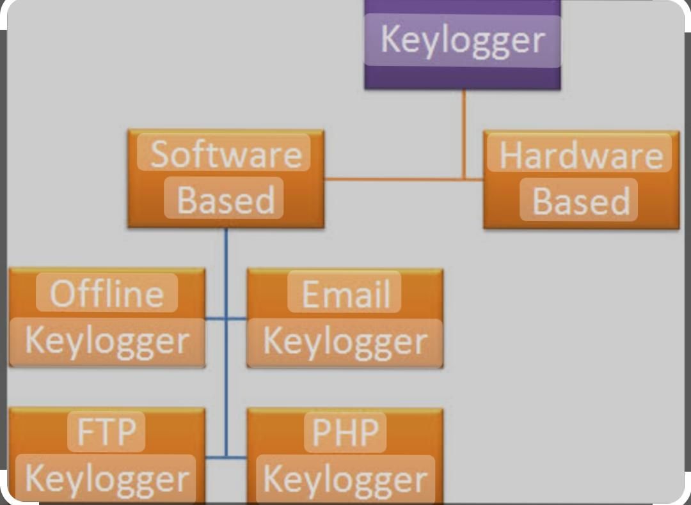
Proposed solution
To combat the rising threat of keyloggers in our digital landscape, a multi-faceted approach is essential. This includes implementing robusantivirus and anti-malware software, regularly updating operating systems and applications to patch vulnerabilities, utilizing firewall protection, practicing safe browsing habits, such as avoiding suspicious links and downloads, and employing encryption for sensitive data transmission. Additionally, promoting cybersecurity awareness among users through training and education programs can empower individuals and organizations to recognize and thwart keylogger threats effectively.

Slide 5
System approach
A systemic approach to addressing the threat of keyloggers involves multiple layers of defense: 1.Prevention: Educate users about safe computing practices, such as avoiding suspicious links and downloads, and regularly updating antivirus software. Employing firewalls, intrusion detection systems, and access controls can also help prevent keyloggers from gaining access to systems. 2.Detection: Implement robust monitoring systems that can detect unusual behavior indicative of keylogger activity, such as unexpected data transmissions or changes in system performance. Employing endpoint security solutions that specifically detect and block keyloggers can also enhance detection capabilities.

Slide 6
Encryption: Implement strong encryption for sensitive data both at rest and in transit to make it more difficult for keyloggers to capture and misuse. Access Control: Enforce strict access control policies to limit the installation and execution of software to authorized users only. This can help prevent the inadvertent installation of keyloggers by users with limited privileges. Regular Security Audits: Conduct regular security audits and penetration testing to identify and address any vulnerabilities in systems and networks that could be exploited by keyloggers and other cyber threats

Slide 7

By taking a systemic approach that combines technical controls, user education, and proactive monitoring, organizations and individuals can better protect themselves against the threat of keyloggers and other cybersecurity risks.

Slide 8
Algorithm and deployment
To combat the threat of keyloggers in today’s digital landscape, a multifaceted algorithm and deployment strategy is essential: Heuristic Analysis Algorithm: Develop a heuristic analysis algorithm to detect anomalous behavior indicative of keylogger activity. Monitor system processes and network traffic for signs of unauthorized data capture or transmission. Analyze patterns of keystrokes to identify irregularities that may signify a keylogging attack.

Slide 9
Integrate keylogger detection capabilities into endpoint security solutions, including antivirus software, intrusion detection systems, and endpoint protection platforms. Provide regular updates and patches to ensure the algorithm remains effective against emerging keylogger threats. Offer cloud-based deployment options for scalability and centralized management across multiple devices and networks.tect sensitive information from theft and misuse.
By implementing these algorithms and deployment strategies, organizations can effectively defend against the proliferation of keyloggers and protect sensitive information from theft and misuse.

Slide 10
Result
In today’s digital age, the proliferation of keyloggers presents a grave concern for cybersecurity. These stealthy software tools are designed to secretly monitor and record keystrokes on a user’s computer, posing a severe threat to both individuals and organizations. Keyloggers have the capability to capture sensitive information such as passwords, credit card details, and personal data, ultimately resulting in identity theft, financial loss, and privacy breaches. As such, it’s crucial for individuals and organizations to remain vigilant and implement robust security measures to protect against this growing threat.

Slide 11
Conclusion
In conclusion, the proliferation of keyloggers presents a significant threat in today’s digital age, where cybersecurity risks are ever-present. These stealthy software tools have the capability to silently monitor and record keystrokes on a user’s computer, compromising sensitive information such as passwords, credit card details, and other personal data. The consequences of keylogger attacks can be severe, leading to identity theft, financial loss, and privacy breaches for individuals and organizations alike.As technology continues to advance, it is crucial for individuals and organizations to remain vigilant and proactive in addressing keylogger threats. Implementing comprehensive security measures, including education and awareness programs, robust security policies and procedures, endpoint and network security solutions, incident response plans, and continuous monitoring and improvement efforts, is essential for mitigating the risk posed by keylogger

Slide 12
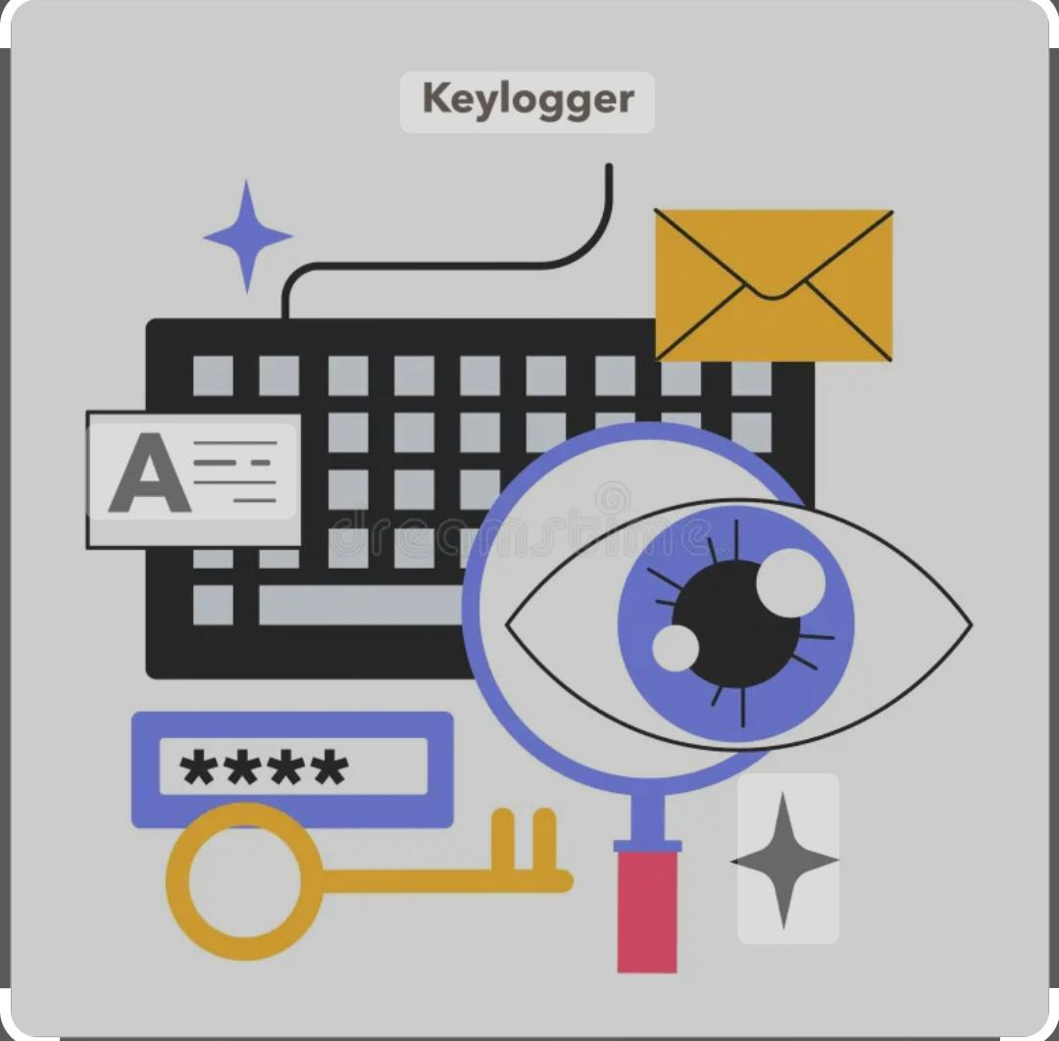
By adopting a systematic and multi-layered approach to cybersecurity, individuals and organizations can better protect themselves against the proliferation of keyloggers and safeguard Their sensitive information
In today’s digital landscape. Collaboration, awareness, and ongoing adaptation to emerging threats are key in the ongoing battle against keylogger proliferation and other cybersecurity challenges.

Slide 13
Future scope
Advanced Detection Techniques: Continued research and development in the field of cybersecurity will lead to the creation of more sophisticated detection techniques for identifying and mitigating keylogger threats. This could involve the use of machine learning algorithms, behavior analysis, and anomaly detection to recognize patterns associated with keylogger activity. Enhanced Endpoint Security Solutions: The development of more robust and intelligent endpoint security solutions will play a crucial role in combating keylogger threats. Future innovations may include the integration of artificial intelligence and predictive analytics to proactively detect and prevent keylogger attacks in real-time. Secure Hardware Solutions: As keyloggers can sometimes exploit vulnerabilities at the hardware level, there is potential for the development of secure hardware solutions

Slide 14
User Education: Increasing awareness among individuals and organizations about the risks of keyloggers and promoting best practices for preventing their installation and mitigating their effects. Regulatory Measures: Enforcing stricter regulations and compliance standards to hold software developers accountable for implementing robust security measures to prevent keylogger infiltration. Collaborative Efforts: Encouraging collaboration between cybersecurity professionals, researchers, and industry stakeholders to share threat intelligence and develop proactive defense strategies against keyloggers.
Notes:
Advanced Detection Techniques: Continued research and development in the field of cybersecurity will lead to the creation of more sophisticated detection techniques for identifying and mitigating keylogger threats. This could involve the use of machine learning algorithms, behavior analysis, and anomaly detection to recognize patterns associated with keylogger activity. Enhanced Endpoint Security Solutions: The development of more robust and intelligent endpoint security solutions will play a crucial role in combating keylogger threats. Future innovations may include the integration of artificial intelligence and predictive analytics to proactively detect and prevent keylogger attacks in real-time. Secure Hardware Solutions: As keyloggers can sometimes exploit vulnerabilities at the hardware level, there is potential for the development of secure hardware solutions

Slide 15

Collaborative Efforts: Encouraging collaboration between cybersecurity professionals, researchers, and industry stakeholders to share threat intelligence and develop proactive defense strategies against keyloggers. By focusing on these areas, we can enhance our defenses against keyloggers and mitigate the risks they pose to individuals and organizations in the digital age

Slide 16
References
Sood, Aditya K., et al. “A taxonomy of keyloggers and detection approaches.” Security & Privacy, IEEE 9.5 (2011): 25-32. Bu, Feifei, et al. “Detecting keylogger attacks with keystroke behavioral biometrics.” Proceedings of the 2010 IEEE Symposium on Security and Privacy. IEEE Computer Society, 2010.
Barisani, Andrea, and Daniele Bianco. “Keyloggers: A dangerous threat to corporate and personal security.” Black Hat Briefings (2005): 1-11. Lantz, Brett. “The dangers of keyloggers and how to combat them.” SANS Institute InfoSec Reading Room (2014).

Slide 17
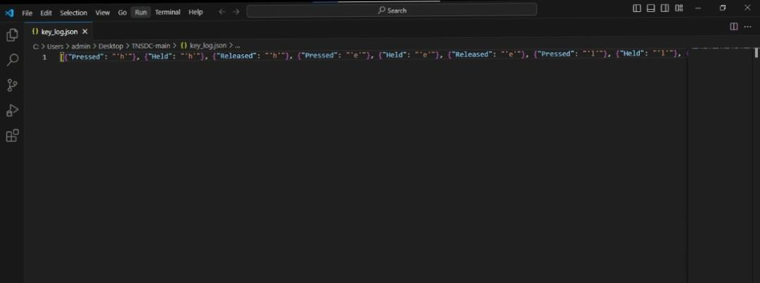
Example

Slide 18
Example
H’’e’’l’’l’’o’Key.enter

Slide 19
Example
{“Pressed”: “’v’”}, {“Held”: “’v’”}, {“Released”: “’v’”}, {“Pressed”: “’a’”}, {“Held”: “’a’”}, {“Released”: “’a’”}, {“Pressed”: “’n’”}, {“Held”: “’n’”}, {“Released”: “’n’”}, {“Pressed”: “Key.backspace”}, {“Held”: “Key.backspace”}, {“Released”: “Key.backspace”}, {“Pressed”: “’t’”}, {“Held”: “’t’”}, {“Held”: “’h’”}, {“Released”: “’t’”}, {“Released”: “’h’”}, {“Pressed”: “’a’”}, {“Held”: “’a’”}, {“Released”: “’a’”}, {“Pressed”: “’n’”}, {“Held”: “’n’”}, {“Released”: “’n’”}, {“Pressed”: “’a’”}, {“Held”: “’a’”}, {“Released”: “’a’”}, {“Pressed”: “’u’”}, {“Held”: “’u’”}, {“Released”: “’u’”}, {“Pressed”: “’t’”}, {“Held”: “’t’”}, {“Held”: “’h’”}, {“Released”: “’t’”}, {“Released”: “’h’”}, {“Pressed”: “’a’”}, {“Held”: “’a’”}, {“Released”: “’a’”}, {“Pressed”: “’y’”}, {“Held”: “’y’”}, {“Released”: “’y’”}, {“Pressed”: “’a’”}, {“Held”: “’a’”}, {“Released”: “’a’”}, {“Pressed”: “’k’”}, {“Held”: “’k’”}, {“Released”: “’k’”}, Released”: “’a’”}, {“Pressed”: “’y’”}, {“Held”: “’y’”}, {“Released”: “’y’”}, {“Pressed”: “’a’”}, {“Held”: “’a’”}, {“Released”: “’a’”}, {“Pressed”: “’k’”}, {“Held”: “’k’”}, {“Released”: “’k’”}, {“Pressed”: “’u’”}, {“Held”: “’u’”}, {“Released”: “’u’”}, {“Pressed”: “’m’”}, {“Held”: “’m’”}, {“Released”: “’m’”}, {“Pressed”: “’a’”}, {“Held”: “’a’”}, {“Released”: “’a’”}, {“Pressed”: “’r’”}, {“Held”: “’r’”}, {“Released”: “’r’”}, {“Pressed”: “’v’”}, {“Held”: “’v’”}, {“Held”: “’a’”}, {“Released”: “’v’”}, {“Released”: “’a’”}, {“Pressed”: “’t’”}, {“Held”: “’t’”}, {“Released”: “’t’”}, {“Pressed”: “’h’”}, {“Held”: “’h’”}, {“Released”: “’h’”}, {“Pressed”: “’a’”}, {“Held”: “’a’”}, {“Released”: “’a’”}, {“Pressed”: “’n’”}, {“Held”: “’n’”}, {“Released”: “’n’”}, {“Pressed”: “’a’”}, {“Held”: “’a’”}, {“Released”: “’a’”}, {“Pressed”: “’u’”}, {“Held”: “’u’”}, {“Released”: “’u’”}, {“Pressed”: “’t’”}, {“Held”: “’t’”}, {“Released”: “’t’”}, {“Pressed”: “’h’”}, {“Held”: “’h’”}, {“Released”: “’h’”}, {“Pressed”: “’y’”}, {“Held”: “’y’”}, {“Released”: “’y’”}, {“Pressed”: “’a’”}, {“Held”: “’a’”}, {“Released”: “’a’”}, {“Pressed”: “’k’”}, {“Held”: “’k’”}, {“Released”: “’k’”}, {“Pressed”: “’u’”}, {“Held”: “’u’”}, {“Released”: “’u’”},

Slide 20
“Pressed”: “’h’”}, {“Held”: “’h’”}, {“Released”: “’h’”}, {“Pressed”: “’a’”}, {“Held”: “’a’”}, {“Released”: “’a’”}, {“Pressed”: “’r’”}, {“Held”: “’r’”}, {“Released”: “’r’”}, {“Pressed”: “’s’”}, {“Held”: “’s’”}, {“Released”: “’s’”}, {“Pressed”: “’h’”}, {“Held”: “’h’”}, {“Released”: “’h’”}, {“Pressed”: “’i’”}, {“Held”: “’i’”}, {“Released”: “’i’”}, {“Pressed”: “’n’”}, {“Held”: “’n’”}, {“Released”: “’n’”}, {“Pressed”: “’i’”}, {“Held”: “’i’”}, {“Released”: “’i’”}, {“Pressed”: “Key.backspace”}, {“Held”: “Key.backspace”}, {“Held”: “Key.backspace”}, {“Held”: “Key.backspace”}, {“Held”: “Key.backspace”}, {“Held”: “Key.backspace”}, {“Held”: “Key.backspace”}, {“Held”: “Key.backspace”}, {“Held”: “Key.backspace”}, {“Held”: “Key.backspace”}, {“Held”: “Key.backspace”}, {“Released”: “Key.backspace”}, {“Pressed”: “Key.backspace”}, {“Held”: “Key.backspace”}, {“Released”: “Key.backspace”}, {“Pressed”: “’j’”}, {“Held”: “’j’”}, {“Released”: “’j’”}, {“Pressed”: “’i’”}, {“Held”: “’i’”}, {“Released”: “’i’”}, {“Pressed”: “’k’”}, {“Held”: “’k’”}, {“Held”:a’”}, {“Released”: “’k’”}, {“Pressed”: “’l’”}, {“Held”: “’l’”}, {“Released”: “’a’”}, {“Released”: “’l’”}, {“Pressed”: “’a’”}, {“Held”: “’a’”}, {“Released”: “’a’”}, {“Pressed”: “’i’”}, {“Held”: “’i’”}, {“Released”: “’i’”}, {“Pressed”: “’s’”}, {“Held”: “’s’”}, {“Released”: “’s’”}, {“Pressed”: “’e’”}, {“Held”: “’e’”}, {“Released”: “’e’”}, {“Pressed”: “’l’”}, {“Held”: “’l’”}, {“Released”: “’l’”}, {“Pressed”: “’v’”}, {“Held”: “’v’”}, {“Released”: “’v’”}, {“Pressed”: “’a’”}, {“Held”: “’a’”}, {“Released”: “’a’”}, {“Pressed”: “’n’”}, {“Held”: “’n’”}, {“Released”: “’n’”}, {“Pressed”: “’1’”}, {“Held”: “’1’”}, {“Released”: “’1’”}, {“Pressed”: “’7’”}, {“Held”: “’7’”}, {“Released”: “’7’”}, {“Pressed”: “Key.shift”}, {“Held”: “Key.shift”}, {“Held”: “’@’”}, {“Released”: “’@’”}, {“Released”: “Key.shift”

Slide 21
Pressed”: “’g’”}, {“Held”: “’g’”}, {“Released”: “’g’”}, {“Pressed”: “’m’”}, {“Held”: “’m’”}, {“Released”: “’m’”}, {“Pressed”: “’a’”}, {“Held”: “’a’”}, {“Held”: “’i’”}, {“Released”: “’a’”}, {“Released”: “’i’”}, {“Pressed”: “’l’”}, {“Held”: “’l’”}, {“Released”: “’l’”}, {“Pressed”: “’.’”}, {“Held”: “’.’”}, {“Released”: “’.’”}, {“Pressed”: “’c’”}, {“Held”: “’c’”}, {“Held”: “’o’”}, {“Released”: “’c’”}, {“Released”: “’o’”}, {“Pressed”: “’m’”}, {“Held”: “’m’”}, {“Released”: “’m’”}, {“Pressed”: “Key.ctrl_l”}, {“Held”: “Key.ctrl_l”}, {“Held”: “Key.ctrl_l”}, {“Held”: “Key.ctrl_l”}, {“Held”: “Key.ctrl_l”}, {“Held”: “Key.ctrl_l”}, {“Held”: “Key.ctrl_l”}, {“Held”: “Key.ctrl_l”}, {“Held”: “Key.ctrl_l”}, {“Held”: “Key.ctrl_l”}, {“Held”: “Key.ctrl_l”}, {“Held”: “Key.ctrl_l”}, {“Held”: “Key.ctrl_l”}, {“Held”: “Key.ctrl_l”}, {“Held”: “’\\x16’”}, {“Released”: “’\\x16’”}, {“Pressed”: “’\\x01’”}, {“Held”: “’\\x01’”}, {“Released”: “’\\x01’”},Released”: “’\\x16’”}, {“Pressed”: “’\\x01’”}, {“Held”: “’\\x01’”}, {“Released”: “’\\x01’”}, {“Released”: “Key.ctrl_l”}, {“Pressed”: “Key.ctrl_l”}, {“Held”: “Key.ctrl_l”}, {“Held”: “Key.ctrl_l”}, {“Held”: “Key.ctrl_l”}, {“Held”: “Key.ctrl_l”}, {“Held”: “’\\x01’”}, {“Released”: “’\\x01’”}, {“Released”: “Key.ctrl_l”}, {“Pressed”: “Key.ctrl_l”}, {“Held”: “Key.ctrl_l”}, {“Released”: “Key.ctrl_l”}, {“Pressed”: “Key.ctrl_l”}, {“Held”: “Key.ctrl_l”}, {“Held”: “Key.ctrl_l”}, {“Held”: “Key.ctrl_l”}, {“Held”: “Key.ctrl_l”}, {“Held”: “Key.ctrl_l”}, {“Held”: “Key.ctrl_l”}, {“Held”: “Key.ctrl_l”}, {“Held”: “Key.ctrl_l”}, {“Held”: “Key.ctrl_l”}, {“Held”: “Key.ctrl_l”}, {“Held”: “Key.ctrl_l”}, {“Held”: “Key.ctrl_l”}, {“Held”: “’\\x03’”}, {“Released”: “Key.ctrl_l”}, {“Released”: “’c’”}, {“Pressed”: “Key.ctrl_l”}, {“Held”: “Key.ctrl_l”}, {“Held”: “’\\x16’”}, {“Released”: “’\\x16’”}, {“Released”: “Key.ctrl_l”}, {“Pressed”: “’k’”}, {“Held”: “’k’”}, {“Released”: “’k’”}, {“Pressed”: “’e’”}, {“Held”: “’e’”}, {“Released”: “’e’”}, {“Pressed”: “’y’”}, {“Held”: “’y’”},

Slide 22
Released”: “’y’”}, {“Pressed”: “’l’”}, {“Held”: “’l’”}, {“Released”: “’l’”}, {“Pressed”: “’o’”}, {“Held”: “’o’”}, {“Released”: “’o’”}, {“Pressed”: “’g’”}, {“Held”: “’g’”}, {“Released”: “’g’”}, {“Pressed”: “’g’”}, {“Held”: “’g’”}, {“Released”: “’g’”}, {“Pressed”: “’e’”}, {“Held”: “’e’”}, {“Held”: “’r’”}, {“Released”: “’e’”}, {“Released”: “’r’”}, {“Pressed”: “’s’”}, {“Held”: “’s’”}, {“Released”: “’s’”}, {“Pressed”: “’.’”}, {“Held”: “’.’”}, {“Released”: “’.’”}, {“Pressed”: “’p’”}, {“Held”: “’p’”}, {“Released”: “’p’”}, {“Pressed”: “’y’”}, {“Held”: “’y’”}, {“Released”: “’y’”}, {“Pressed”: “Key.enter”}, {“Held”: “Key.enter”}, {“Released”: “Key.enter”}, {“Pressed”: “’c’”}, {“Held”: “’c’”}, {“Released”: “’c’”}, {“Pressed”: “’m’”}, {“Held”: “’m’”}, {“Released”: “’m’”}, {“Pressed”: “’d’”}, {“Held”: “’d’”}, {“Released”: “’d’”}]

Slide 23


